Slide 1
Hidden Markov Model
Il-Chul Moon
Dept. of Industrial and Systems Engineering
KAIST
icmoon@kaist.ac.kr

Slide 2
Weekly Objectives
Learn hidden Markov model
  Transition from the static clustering to the dynamic clustering
  Understand the difference of the graphical model
Know and able to answer the three major questions of HMM
  Know how to solve the evaluation question
  Know how to solve the decoding question
  Know how to solve the learning question
Link to the previous lectures
  Link the forward-backward algorithm to the message passing
  Link the baum-welch algorithm to the EM algorithm

Slide 3
Baum-welch algorithm

Slide 4
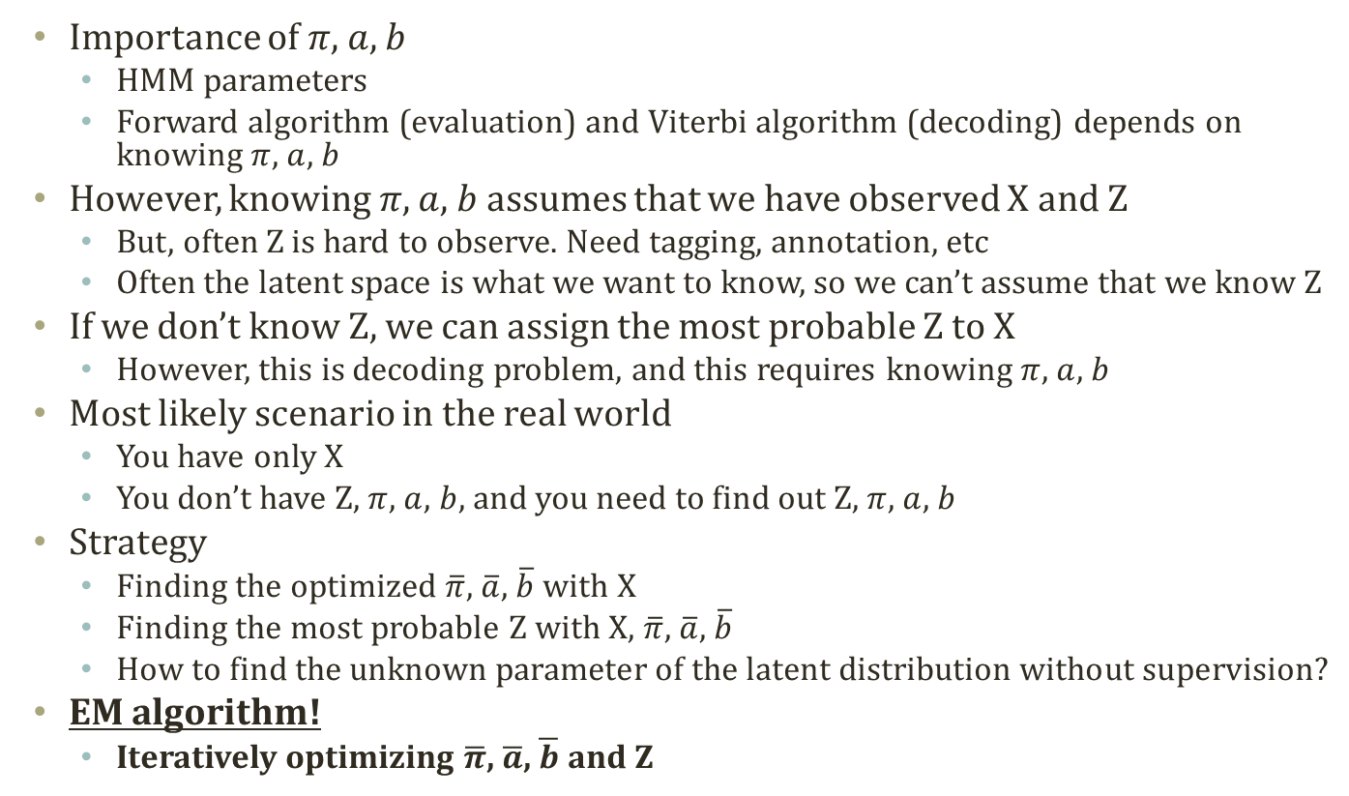
Learning Parameters with Only X
Importance of $π$, $a$, $b$
  HMM parameters
  Forward algorithm (evaluation) and Viterbi algorithm (decoding) depends on knowing $π$, $a$, $b$
However, knowing $π$, $a$, $b$ assumes that we have observed X and Z
  But, often Z is hard to observe. Need tagging, annotation, etc
  Often the latent space is what we want to know, so we can’t assume that we know Z
If we don’t know Z, we can assign the most probable Z to X
  However, this is decoding problem, and this requires knowing $π$, $a$, $b$
Most likely scenario in the real world
  You have only X
  You don’t have Z, $π$, $a$, $b$, and you need to find out Z, $π$, $a$, $b$
Strategy
  Finding the optimized $\overline{π}$, $\overline{a}$, $\overline{b}$ with X
  Finding the most probable Z with X, $\overline{π}$, $\overline{a}$, $\overline{b}$
  How to find the unknown parameter of the latent distribution without supervision?
EM algorithm!
  Iteratively optimizing $\overline{π}$, $\overline{a}$, $\overline{b}$ and Z

Slide 5
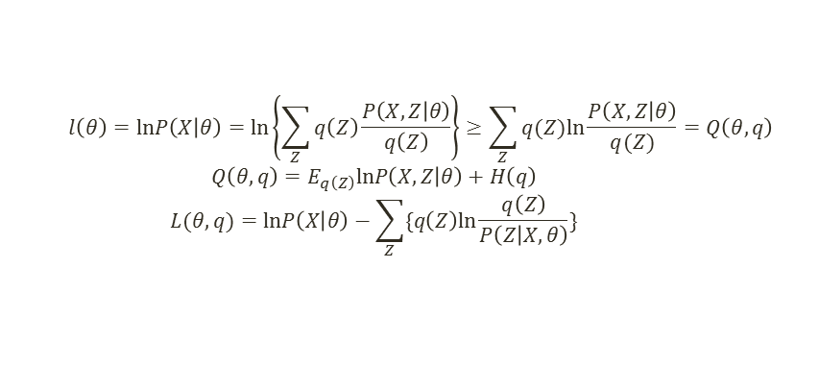
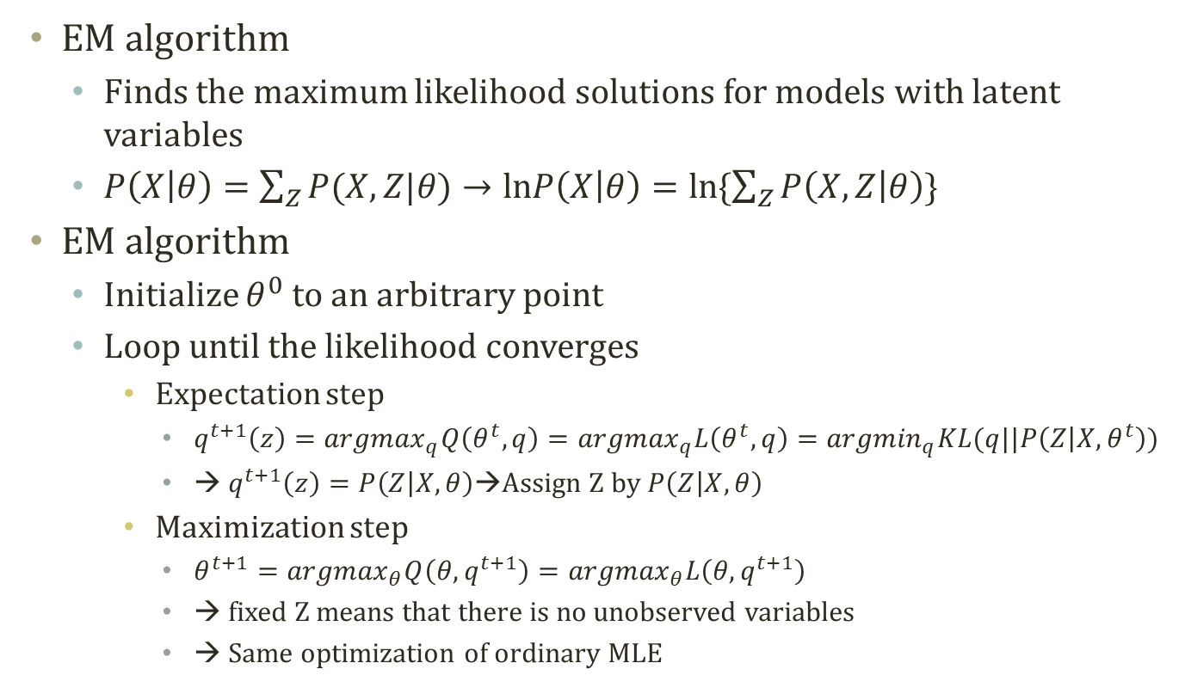
Detour: EM Algorithm
  $$l\left(θ\right)=lnP\left(X | θ\right)=ln\left\{\sum_{Z}{q\left(Z\right)\frac{P\left(X,Z | θ\right)}{q\left(Z\right)}}\right\}≥\sum_{Z}{q(Z)ln\frac{P\left(X,Z | θ\right)}{q(Z)}}=Q\left(θ,q\right)$$
  $$Q\left(θ,q\right)=E_{q\left(Z\right)}lnP\left(X,Z | θ\right)+H\left(q\right)$$
  $$L(θ,q)=lnP\left(X | θ\right)−\sum_{Z}{\{q\left(Z\right)ln\frac{q\left(Z\right)}{P\left(Z | X,θ\right)}\}}$$
EM algorithm
  Finds the maximum likelihood solutions for models with latent variables
  $P\left(X | θ\right)=\sum_{Z}{P(X,Z|θ)}→lnP\left(X | θ\right)=ln\{\sum_{Z}{P\left(X,Z | θ\right)}\}$
EM algorithm
  Initialize $θ^{0}$ to an arbitrary point
  Loop until the likelihood converges
    Expectation step
      $q^{t+1}\left(z\right)={argmax}_{q}Q\left(θ^{t},q\right)={argmax}_{q}L\left(θ^{t},q\right)={argmin}_{q}KL(q||P\left(Z | X,θ^{t}\right))$
      → $q^{t+1}\left(z\right)=P\left(Z | X,θ\right)$→Assign Z by $P\left(Z | X,θ\right)$
    Maximization step
      $θ^{t+1}={argmax}_{θ}Q\left(θ,q^{t+1}\right)={argmax}_{θ}L\left(θ,q^{t+1}\right)$
      → fixed Z means that there is no unobserved variables
      → Same optimization of ordinary MLE

Slide 6
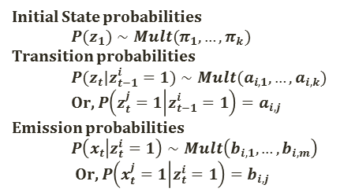
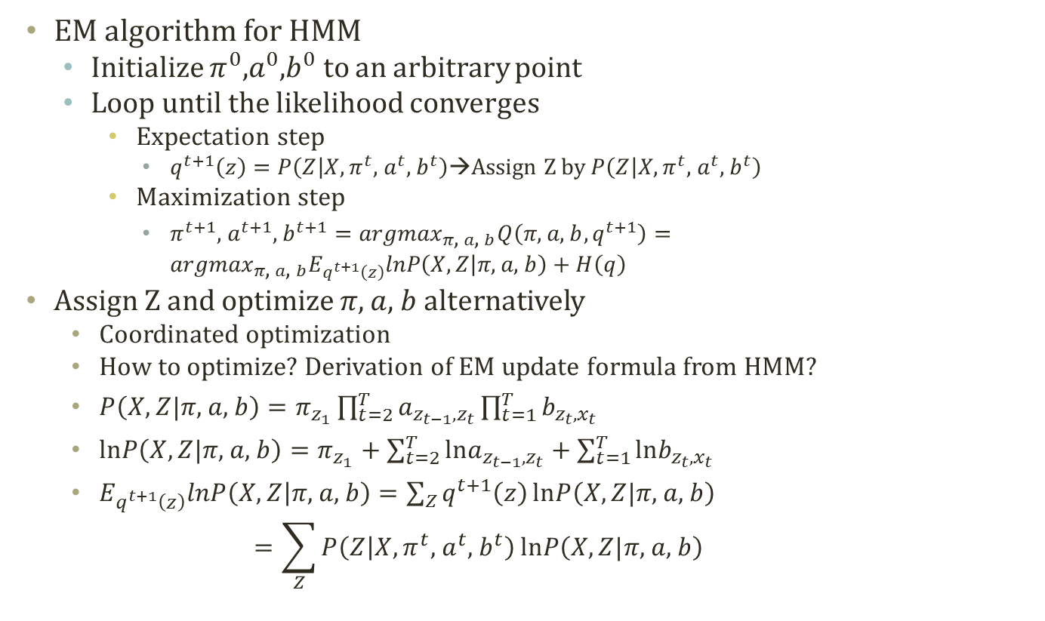
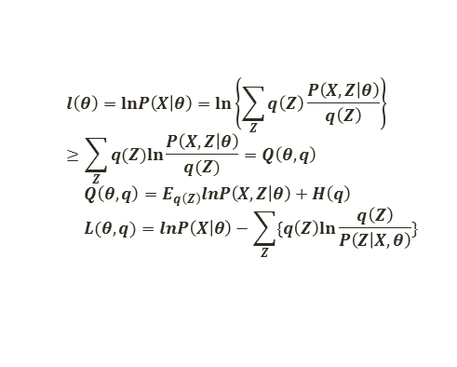
EM for HMM
  $$l\left(θ\right)=lnP\left(X | θ\right)=ln\left\{\sum_{Z}{q\left(Z\right)\frac{P\left(X,Z | θ\right)}{q\left(Z\right)}}\right\}≥\sum_{Z}{q(Z)ln\frac{P\left(X,Z | θ\right)}{q(Z)}}=Q\left(θ,q\right)$$
  $$Q\left(θ,q\right)=E_{q\left(Z\right)}lnP\left(X,Z | θ\right)+H\left(q\right)$$
  $$L(θ,q)=lnP\left(X | θ\right)−\sum_{Z}{\{q\left(Z\right)ln\frac{q\left(Z\right)}{P\left(Z | X,θ\right)}\}}$$
Initial State probabilities
  $$P(z_{1})∼Mult(π_{1},…,π_{k})$$
Transition probabilities
  $$P(z_{t}|z_{t−1}^{i}=1)∼Mult(a_{i,1},…,a_{i,k})$$
  Or, $P\left(z_{t}^{j}=1 | z_{t−1}^{i}=1\right)=a_{i,j}$
Emission probabilities
  $$P\left(x_{t} | z_{t}^{i}=1\right)∼Mult\left(b_{i,1},…,b_{i,m}\right)$$
  Or, $P\left(x_{t}^{j}=1 | z_{t}^{i}=1\right)=b_{i,j}$
EM algorithm for HMM
  Initialize $π^{0}$,$a^{0}$,$b^{0}$ to an arbitrary point
  Loop until the likelihood converges
    Expectation step
      $q^{t+1}\left(z\right)=P\left(Z | X,π^{t}\text{, }a^{t}\text{, }b^{t}\right)$→Assign Z by $P\left(Z | X,π^{t}\text{, }a^{t}\text{, }b^{t}\right)$
    Maximization step
      $π^{t+1}\text{, }a^{t+1}\text{, }b^{t+1}={argmax}_{π\text{, }a\text{, }b}Q\left(π\text{, }a\text{, }b,q^{t+1}\right)={argmax}_{π\text{, }a\text{, }b}E_{q^{t+1}\left(z\right)}lnP\left(X,Z | π\text{, }a\text{, }b\right)+H\left(q\right)$
  Assign Z and optimize $π$, $a$, $b$ alternatively
    Coordinated optimization
    How to optimize? Derivation of EM update formula from HMM?
    $P\left(X,Z|π\text{, }a\text{, }b\right)=π_{z_{1}}\prod_{t=2}^{T}{a_{z_{t−1},z_{t}}}\prod_{t=1}^{T}{b_{z_{t},x_{t}}}$
    $lnP\left(X,Z|π\text{, }a\text{, }b\right)=π_{z_{1}}+\sum_{t=2}^{T}{lna_{z_{t−1},z_{t}}}+\sum_{t=1}^{T}{lnb_{z_{t},x_{t}}}$
    $E_{q^{t+1}\left(z\right)}lnP\left(X,Z | π\text{, }a\text{, }b\right)=\sum_{Z}{q^{t+1}\left(z\right)}lnP\left(X,Z|π\text{, }a\text{, }b\right)$
    $=\sum_{Z}{P\left(Z | X,π^{t}\text{, }a^{t}\text{, }b^{t}\right)}lnP\left(X,Z|π\text{, }a\text{, }b\right)$

Slide 7
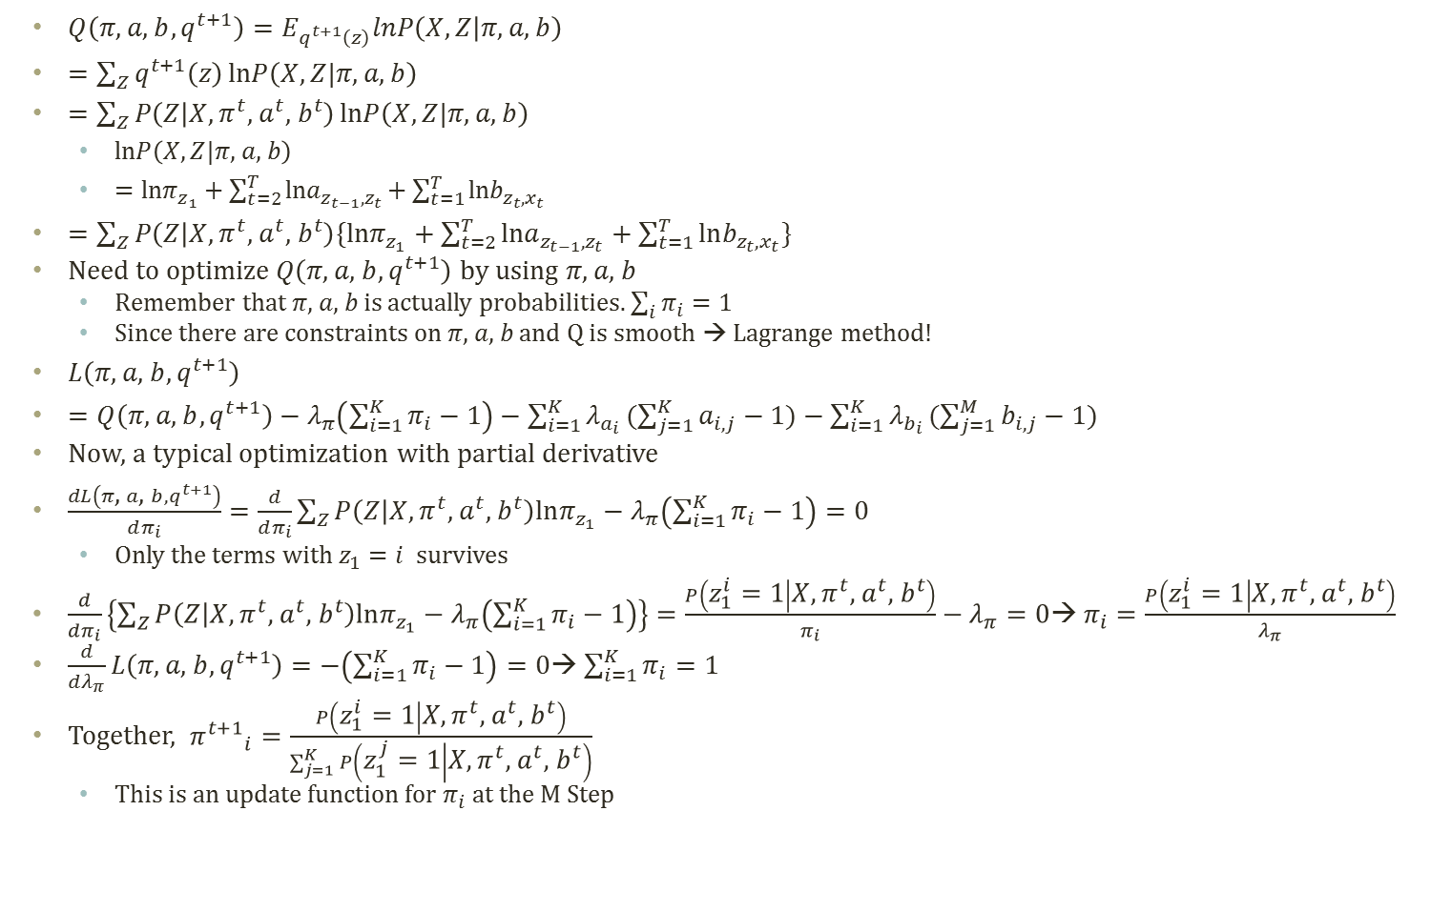

Derivation of EM Update Formula
Similarly, we can compute the update formula for a and b with the partial derivatives
$${a^{t+1}}_{i,j}=\frac{\sum_{t=2}^{T}{P\left(z_{t−1}^{i}=1,z_{t}^{j}=1 | X,π^{t}\text{, }a^{t}\text{, }b^{t}\right)}}{\sum_{t=2}^{T}{P\left(z_{t−1}^{i}=1 | X,π^{t}\text{, }a^{t}\text{, }b^{t}\right)}}$$
$${b^{t+1}}_{i,j}=\frac{\sum_{t=1}^{T}{P\left(z_{t}^{i}=1 | X,π^{t}\text{, }a^{t}\text{, }b^{t}\right)δ(idx(x_{t})=j)}}{\sum_{t=1}^{T}{P\left(z_{t}^{i}=1 | X,π^{t}\text{, }a^{t}\text{, }b^{t}\right)}}$$
$Q\left(π\text{, }a\text{, }b,q^{t+1}\right)=E_{q^{t+1}\left(z\right)}lnP\left(X,Z | π\text{, }a\text{, }b\right)$
$=\sum_{Z}{q^{t+1}\left(z\right)}lnP\left(X,Z|π\text{, }a\text{, }b\right)$
$=\sum_{Z}{P\left(Z | X,π^{t}\text{, }a^{t}\text{, }b^{t}\right)}lnP\left(X,Z|π\text{, }a\text{, }b\right)$
  $lnP\left(X,Z|π\text{, }a\text{, }b\right)$
  $=lnπ_{z_{1}}+\sum_{t=2}^{T}{lna_{z_{t−1},z_{t}}}+\sum_{t=1}^{T}{lnb_{z_{t},x_{t}}}$
$=\sum_{Z}{P\left(Z | X,π^{t}\text{, }a^{t}\text{, }b^{t}\right)\{lnπ_{z_{1}}+\sum_{t=2}^{T}{lna_{z_{t−1},z_{t}}}+\sum_{t=1}^{T}{lnb_{z_{t},x_{t}}}\}}$
Need to optimize $Q\left(π\text{, }a\text{, }b,q^{t+1}\right)$ by using $π\text{, }a\text{, }b$
  Remember that $π\text{, }a\text{, }b$ is actually probabilities. $\sum_{i}{π_{i}}=1$
  Since there are constraints on $π\text{, }a\text{, }b$ and Q is smooth → Lagrange method!
$L\left(π\text{, }a\text{, }b,q^{t+1}\right)$
$=Q\left(π\text{, }a\text{, }b,q^{t+1}\right)−λ_{π}\left(\sum_{i=1}^{K}{π_{i}}−1\right)−\sum_{i=1}^{K}{λ_{a_{i}}}(\sum_{j=1}^{K}{a_{i,j}}−1)−\sum_{i=1}^{K}{λ_{b_{i}}}(\sum_{j=1}^{M}{b_{i,j}}−1)$
Now, a typical optimization with partial derivative
$\frac{dL\left(π\text{, }a\text{, }b,q^{t+1}\right)}{dπ_{i}}=\frac{d}{dπ_{i}}\sum_{Z}{P\left(Z | X,π^{t}\text{, }a^{t}\text{, }b^{t}\right)lnπ_{z_{1}}}−λ_{π}\left(\sum_{i=1}^{K}{π_{i}}−1\right)=0$
  Only the terms with $z_{1}=i$ survives
$\frac{d}{dπ_{i}}\left\{\sum_{Z}{P\left(Z | X,π^{t}\text{, }a^{t}\text{, }b^{t}\right)lnπ_{z_{1}}}−λ_{π}\left(\sum_{i=1}^{K}{π_{i}}−1\right)\right\}=\frac{P\left(z_{1}^{i}=1 | X,π^{t}\text{, }a^{t}\text{, }b^{t}\right)}{π_{i}}−λ_{π}=0$→ $π_{i}=\frac{P\left(z_{1}^{i}=1 | X,π^{t}\text{, }a^{t}\text{, }b^{t}\right)}{λ_{π}}$
$\frac{d}{dλ_{π}}L\left(π\text{, }a\text{, }b,q^{t+1}\right)=−\left(\sum_{i=1}^{K}{π_{i}}−1\right)=0$→ $\sum_{i=1}^{K}{π_{i}}=1$
Together, ${π^{t+1}}_{i}=\frac{P\left(z_{1}^{i}=1 | X,π^{t}\text{, }a^{t}\text{, }b^{t}\right)}{\sum_{j=1}^{K}{P\left(z_{1}^{j}=1 | X,π^{t}\text{, }a^{t}\text{, }b^{t}\right)}}$
  This is an update function for $π_{i}$ at the M Step

Slide 8

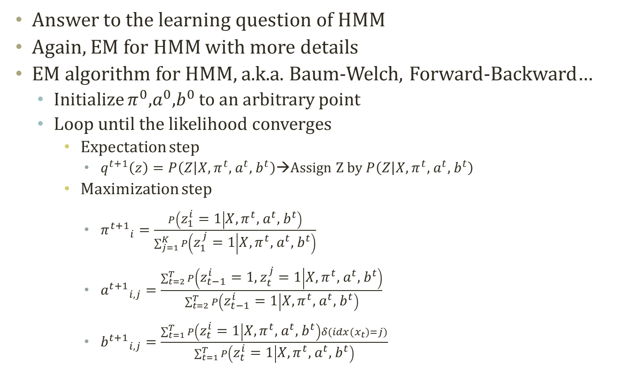

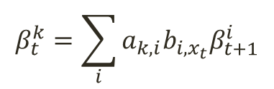
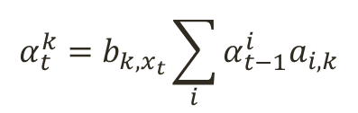
Baum Welch Algorithm
Answer to the learning question of HMM
Again, EM for HMM with more details
EM algorithm for HMM, a.k.a. Baum-Welch, Forward-Backward…
  Initialize $π^{0}$,$a^{0}$,$b^{0}$ to an arbitrary point
  Loop until the likelihood converges
    Expectation step
      $q^{t+1}\left(z\right)=P\left(Z | X,π^{t}\text{, }a^{t}\text{, }b^{t}\right)$→Assign Z by $P\left(Z | X,π^{t}\text{, }a^{t}\text{, }b^{t}\right)$
    Maximization step
      ${π^{t+1}}_{i}=\frac{P\left(z_{1}^{i}=1 | X,π^{t}\text{, }a^{t}\text{, }b^{t}\right)}{\sum_{j=1}^{K}{P\left(z_{1}^{j}=1 | X,π^{t}\text{, }a^{t}\text{, }b^{t}\right)}}$
      ${a^{t+1}}_{i,j}=\frac{\sum_{t=2}^{T}{P\left(z_{t−1}^{i}=1,z_{t}^{j}=1 | X,π^{t}\text{, }a^{t}\text{, }b^{t}\right)}}{\sum_{t=2}^{T}{P\left(z_{t−1}^{i}=1 | X,π^{t}\text{, }a^{t}\text{, }b^{t}\right)}}$
      ${b^{t+1}}_{i,j}=\frac{\sum_{t=1}^{T}{P\left(z_{t}^{i}=1 | X,π^{t}\text{, }a^{t}\text{, }b^{t}\right)δ(idx(x_{t})=j)}}{\sum_{t=1}^{T}{P\left(z_{t}^{i}=1 | X,π^{t}\text{, }a^{t}\text{, }b^{t}\right)}}$
$P\left(z_{t}^{k}=1,X\right)$=$α_{t}^{k}β_{t}^{k}$
$$α_{t}^{k}=b_{k,x_{t}}\sum_{i}{α_{t−1}^{i}a_{i,k}}$$
$$β_{t}^{k}=\sum_{i}{a_{k,i}b_{i,x_{t}}β_{t+1}^{i}}$$
$$\text{P}\text{(}\text{X}\text{)=}\sum_{i}{α_{T}^{i}}$$

